Slide 1



NeCTAR eResearch Tools
Cloud-based Bioinformatics Tools Project
Steering Committee Meeting 31October 2013

Slide 2
Agenda
Action Items from Previous Meeting
Project Report
Progress against milestones
Finance summary
Project Risks and Issues
External Dependencies
Other Business
Approach going forward – an update

Slide 3
Action items from last meeting
Action Item | Status
Based on David’s suggestion, Nik to research validity of QUASAR study as a sample clinical trial | Nik to update.
Ensure Lisa Devereux has direct access to JIRA. | Travis has done this and passed info onto Adrian
David suggested meeting with potential users. Travis to gather users, Nik to provide contacts following a meeting with clinical trials group | Travis took step one - getting a champion of the cause (Lisa Devereux), she is very happy with The Ark and happy to promote it. However, Nik and Eric also suggested the value of the software is greatest once it has the complete suite of tools. As soon as GENO and PEDIGREE near completion, do we then start gathering potential users. Committee: what are your thoughts?
Travis to contact Hepatitis group, Professor Andrew Lloyd UNWA Randwick. | Contact made immediately after meeting with all information sent. No response as yet. (above issue about completing all facilities remains)
David suggested we contact Clinical Trials Centre. Nik to contact Sonia @ CTC & NSW Health, David suggested Martin Stoclar or John Simes | Nik to Update. Should we wait until after we have full suite
Nik to provide contact at Victoria Cancer bio bank. Travis to make contact. | Nik to Update. Should we wait until after we have full suite

Slide 4
Project Report - Milestones
Funding Milestone 1 – Achieved and Payment received
Funding Milestone 2 – Achieved and payment received
Supported Tools and Processes;
Integration with the AAF authentication services;
Deployed in the AAF Test Environment
Have finally received permission to use UWA’s AAF Account to move this into Production at with no ongoing charges
Funding Milestone 3
Integrated invoicing and billing module
Completed and Signed off
Initial Production Research Cloud Deployment
Completed and Signed off

Slide 5
Project Report - Milestones
Funding Milestone 4
A data extraction for analysis module;
100% Complete – signed off.
A pedigree (family) data management and visualisation module;
95% Complete – great progress has been made by Thilina. Adrian has completed a round of testing and Thilina has fixed all suggestions from Adrian except for the validation suggestions in https://the-ark.atlassian.net/browse/ARK-1116.
Funding Milestone 5
Enhanced reporting functionality;
100% Complete – brought ahead of new schedule to balance for pedigree delay
Registry Management functionality
100% Complete (signed off individually now in addition to test cases in Initial Production Deploy sign off)
A Genotypic Data management module
65-75% complete.
Travis will make sure it is completed by amended schedule date of 22nd November this year

Slide 6
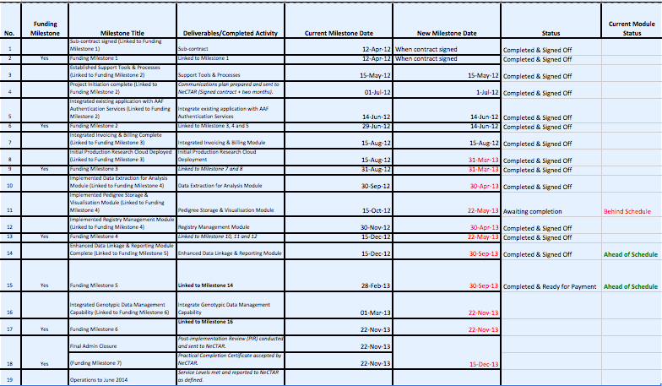
Updated schedule progress

Slide 7
Project Report - Financial
Total project budget: $614,490
Total NeCTAR contribution: $289,000 (note revised down from initial request)
Total co-investment: $324,965
Funds received to-date $156,000
See attached financial report
A restructuring of funding milestones was made in April, it is now approved. For now we are reporting against existing milestones and keeping on track for new milestones to ensure project completed.

Slide 8
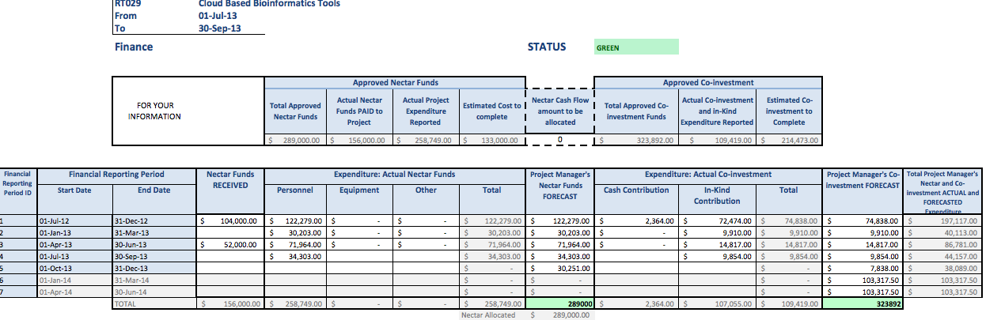
Latest finances as reported 30/9/13

Slide 9
NeCTAR Reporting – Risks
ARK-1118 | Any changes to support plans and new work laid out to ensure future of the project must be carefully planned out to ensure resources are adequate to meet expected functionality. Need to clearly define proposed relationships going forward including how the ark will be manage, expanded, contributed to by 3rd parties going forward into support structure. | Complete documentation and work with all parties on realistic deadlines. We have been working with Nik Zeps on this matter and together will make sure it is very closely managed until formailized | Amber
1 | Availability of appropriately skilled development resources. | We now have the resources required to finish the project by the amended deadline. | Green
2 | Ongoing availability of partner organisation resources. | Resourcing is not currently an issue. | Green
3 | Availability RDSI, AAF and the Research Cloud. | NSP stability is good. UWA will support use of UWA AAF services for production authentication. This is going well but we now have a lot of studies and data and will need more processing power. Travis to address this. The NSP does not have indefinite funding Travis will contribute towards a presentation to eResearch group as Adrian has for John Hopper's group. | Green
ARK-1119 | Need to adequately document how people can use The Ark without support interaction. Some modifications for ease of use may help | We have had several people use it and make recommendations. The time just needs to be committed if we believe that having the tools used externally beyond our management is a goal. Travis believes so in order to harness community contribution, but obviously this needs to be funded. Will seek steering committee opinion | Green

Slide 10
Other Business
Use of The Ark software is on several grants
Korean, African, other prospective projects are making or about to make use of The Ark. This will do well in promoting The Ark, although I believe some refinements to usability for unfamiliar users are necessary. Hopefully it also facilitates international contributors.
Travis and Adrian had been in some talks and providing presentations with potential new users but is there value in presenting the entire suite rather than the current set of tools. Opinions?

Slide 11
Approach Going Forward – part II
All previous discussed approaches are in place, although knowledge sharing needs to progress faster.
Things that I believe need further development after this project;
Enable and entice further collaboration & community environment
Data extraction expanded
Integrate with (or coordinate) analysis pipelines
Improve user (and potential user) education and self help
Automated testing capabilities would be great
Other? Opinions?

